Slide 1




Exploring the Limits of Mineral Abundance Retrievals in the Thermal Infrared From Laboratory Particulate Spectral Analysis
Greta Freeman
Cheng Ye (Mentor)
Christopher Edwards
Northern Arizona University
Arizona Space Grant Symposium April 22, 2023

Slide 2
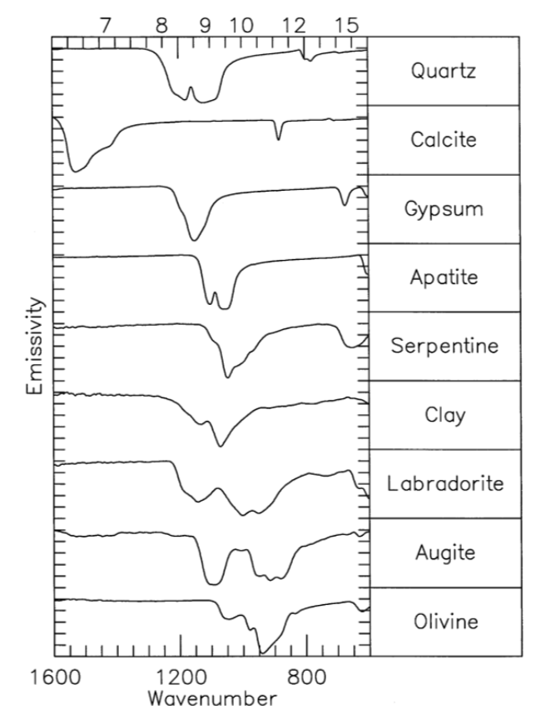
Motivation
Different minerals have characteristic spectra when observed through thermal infrared wavelengths
Grain size has a strong effect on spectra
Linear mixing method widely used, but the uncertainty of differing particle sizes have been insufficiently explored
Goal: Conduct lab experiments to further explore the linear unmixing method and to analyze the accuracy of endmember percentages
Christensen et al., 2004

Slide 3
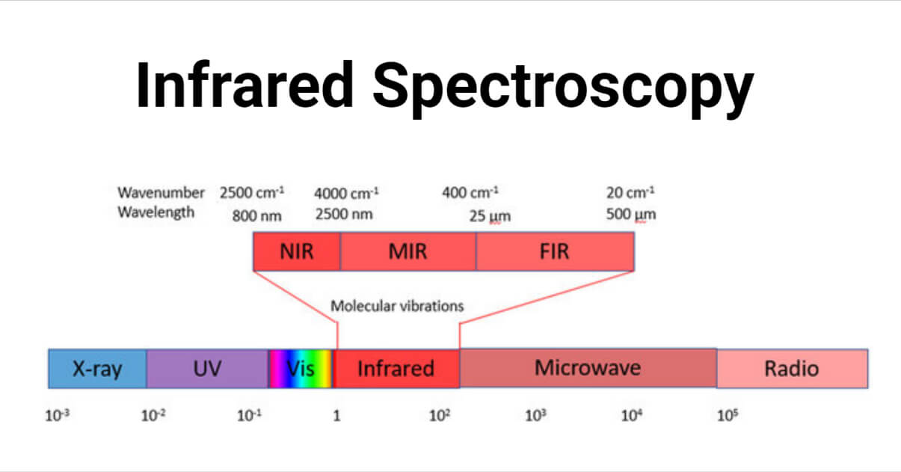
What is Thermal Infrared Emission Spectroscopy?
Spectroscopy that uses the infrared wavelength range
Used to identify surface composition and mineral abundance
Sharma, 2022

Slide 4
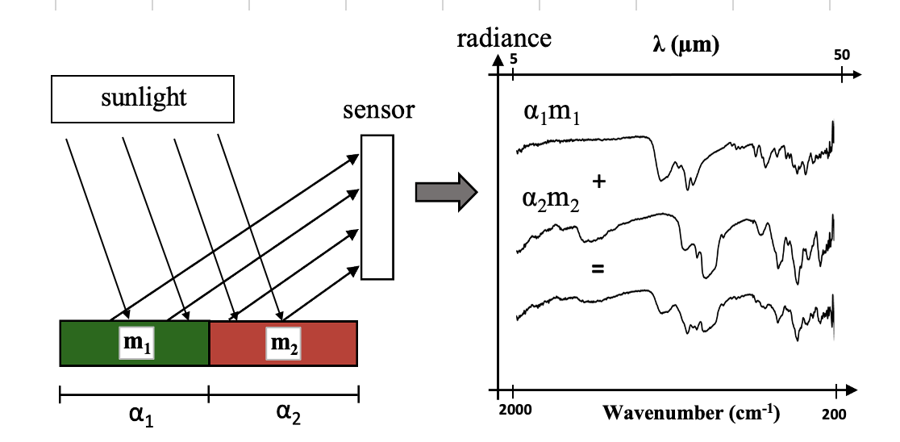
What is Linear Mixing?
Method used to linearly analyze the proportion of mineral abundances
End member = pure mineral sample
  i.e., 100% quartz, 100% calcite
Unmixing: reverse of linear mixing
Used as a tool for infrared spectral analysis of planetary surfaces

Slide 5
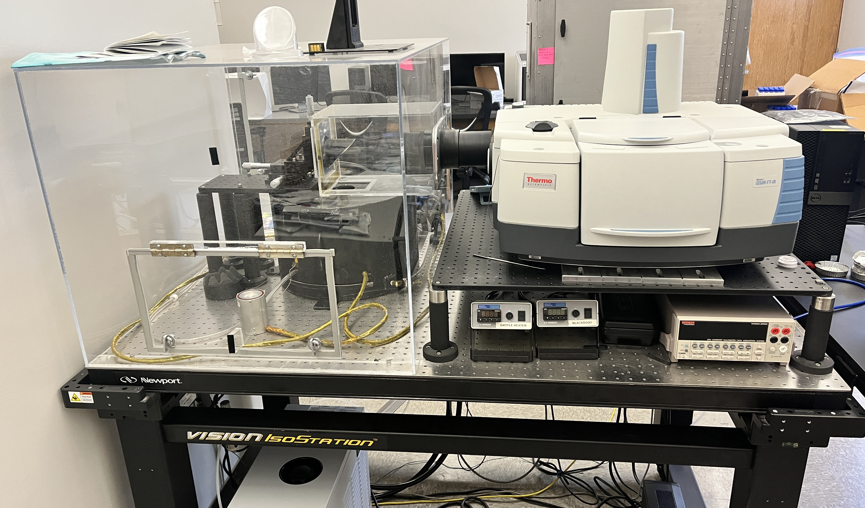
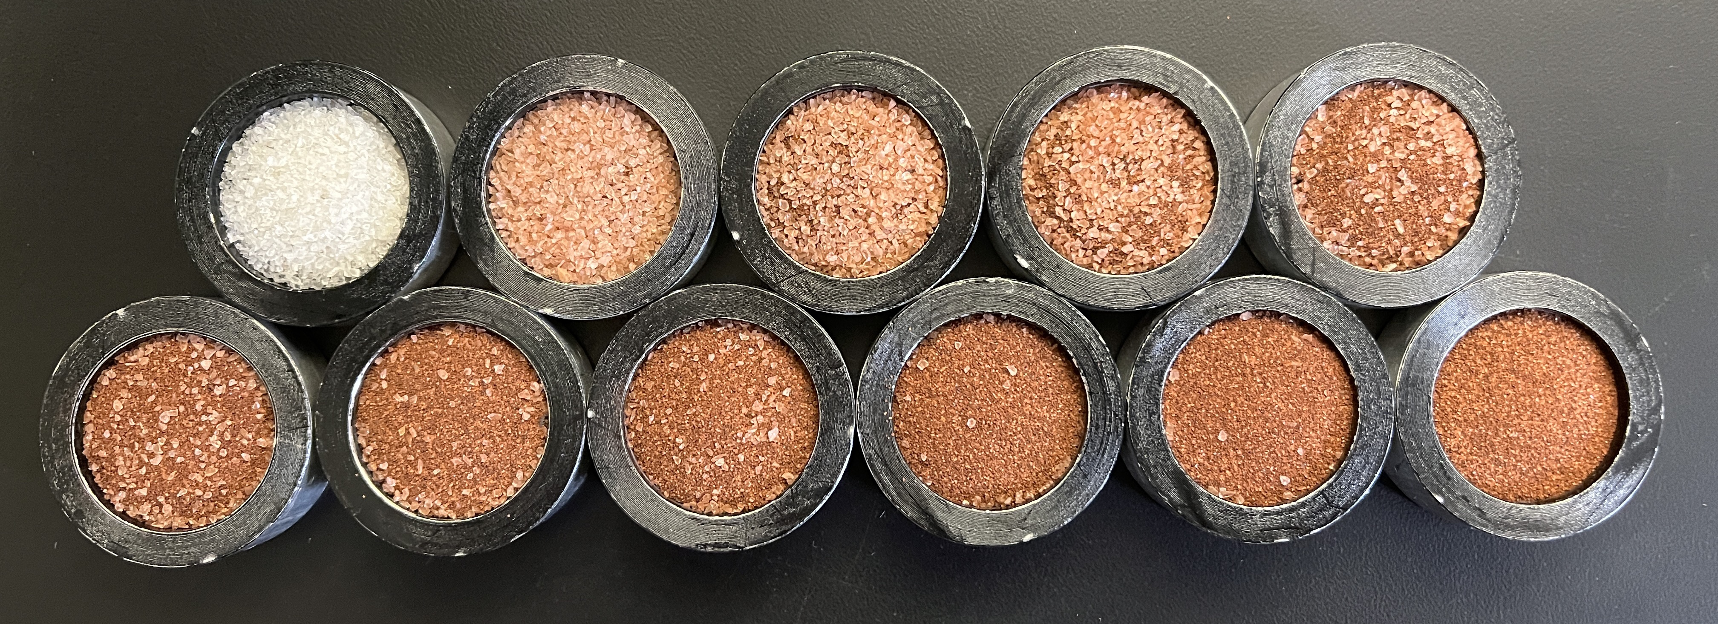
Methods
Prepare mineral mixtures with different particle sizes and end members
Measure emission spectra using Fourier-transform infrared spectroscopy (FTIR)
  Planetary Instrumentation eXploration and Exploratory Laboratory (PIXEL) at NAU
Davinci
  Data processing software developed by ASU
Figure 1: FTIR Spectrometer at NAU
Figure 2: Quartz/Hematite mixtures

Slide 6
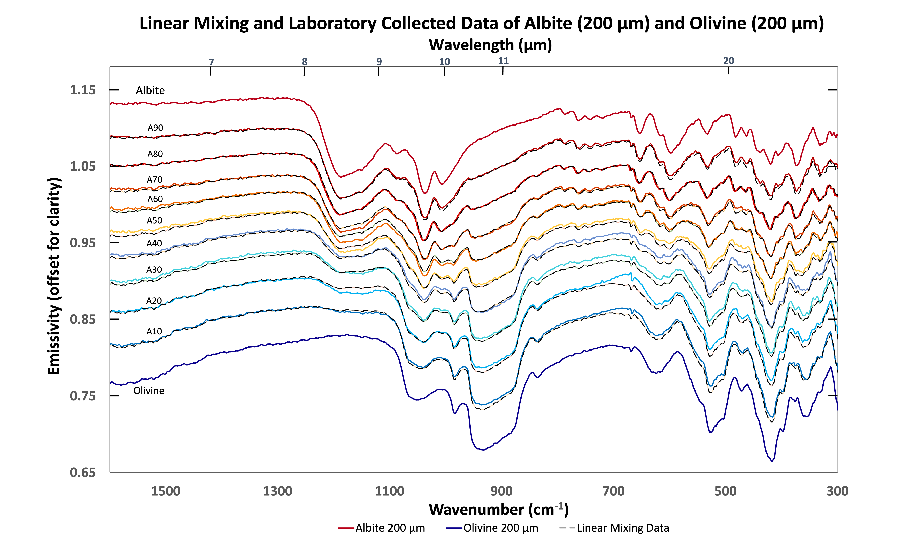
Results
Lab (%) |  | Linear Mixing Error | Linear Unmixing (%)
90 | 10 | 0.00809 | 90 | 10
80 | 20 | 0.0119 | 79 | 21
70 | 30 | 0.0145 | 72 | 28
60 | 40 | 0.0104 | 64 | 36
50 | 50 | 0.0271 | 54 | 46
40 | 60 | 0.00920 | 39 | 61
30 | 70 | 0.0171 | 33 | 67
20 | 80 | 0.0143 | 24 | 76
10 | 90 | 0.0170 | 12 | 88

Slide 7
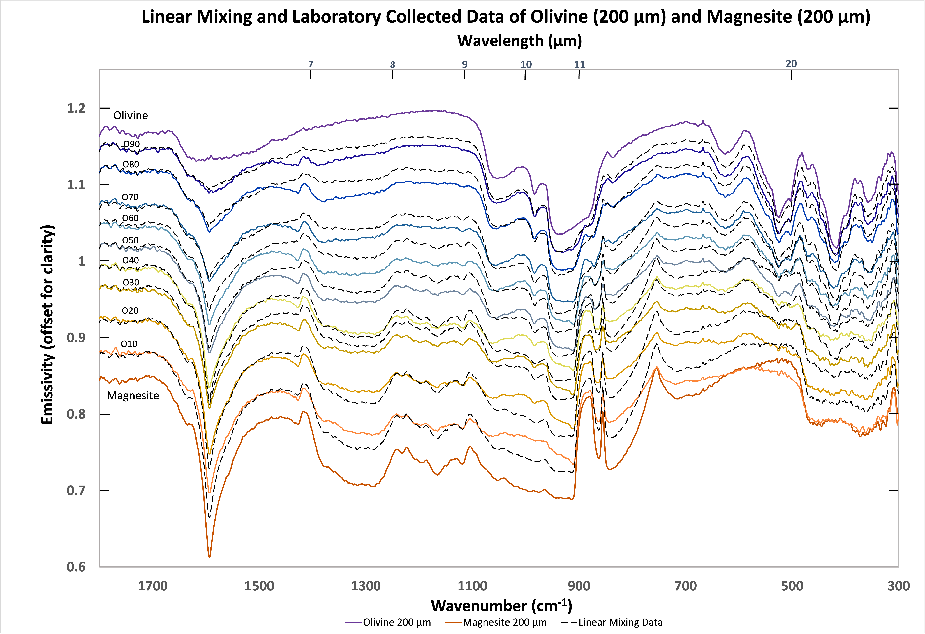
Results
Lab (%) |  | Linear Mixing Error | Linear Unmixing (%)
90 | 10 | 0.0101 | 80 | 20
80 | 20 | 0.0134 | 69 | 31
70 | 30 | 0.0156 | 59 | 41
60 | 40 | 0.0164 | 63 | 37
50 | 50 | 0.0167 | 49 | 51
40 | 60 | 0.0250 | 44 | 56
30 | 70 | 0.0394 | 31 | 69
20 | 80 | 0.0276 | 20 | 80
10 | 90 | 0.0254 | 7 | 93
Notes:
We got a range of results from our experiments

Slide 8
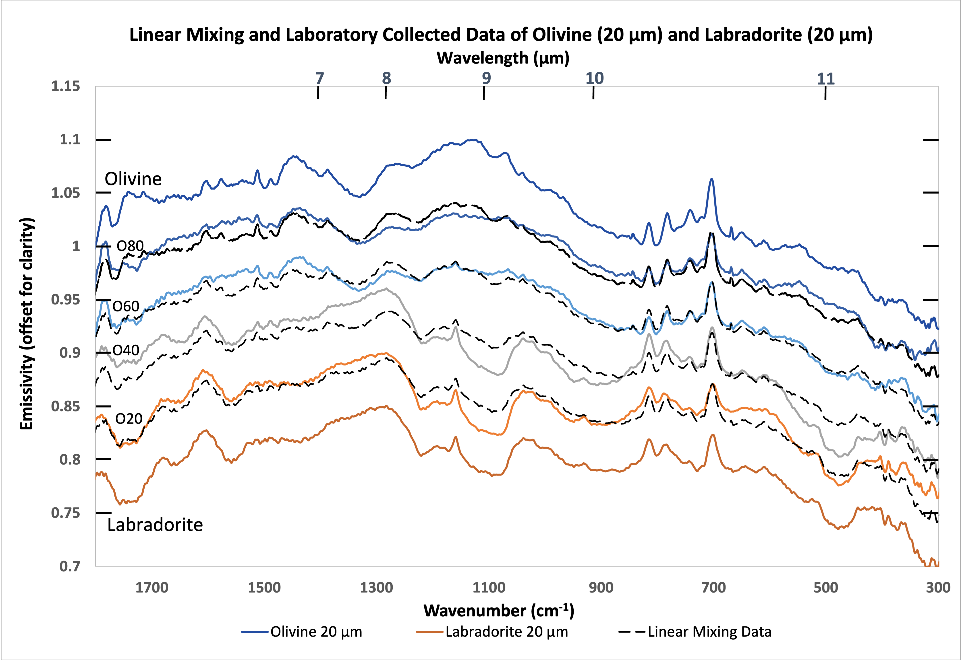
Results
Lab (%) |  | Linear Mixing Error | Linear Unmixing (%)
20 | 80 | 0.0156 | 0 | 100
40 | 60 | 0.0225 | 10 | 90
60 | 40 | 0.0133 | 69 | 31
80 | 20 | 0.0111 | 84 | 16
Notes:
Add values

Slide 9
Conclusion
For each particle size, results vary
  Larger grain sizes produce both good and bad results
  Smaller grains sizes give reasonable values
  Both generate errors
Future Implications:
Fully test the grain size limit of the linear mixing method
Quantify uncertainties in the future work
If the model is valid: combine it with modeling work and apply it to improve remote sensing and laboratory applications

Slide 10
Acknowledgments
I would like to thank the following people for their help throughout my time as an NAU/NASA Space Grant Intern:
Cheng Ye (mentor)
Christopher Edwards
Mark Salvatore
Paloma Davidson

Slide 11
Thank you!

Slide 12
Citations
Sharma, Kabita. “Infrared Spectroscopy- Definition, Principle, Parts, Uses.” The Chemistry Notes, 18 Aug. 2022, https://thechemistrynotes.com/infrared-spectroscopy/.
Christensen, P.R., Jakosky, B.M., Kieffer, H.H. et al. The Thermal Emission Imaging System (THEMIS) for the Mars 2001 Odyssey Mission. Space Science Reviews 110, 85–130 (2004). https://doi.org/10.1023/B:SPAC.0000021008.16305.94

